Slide 1
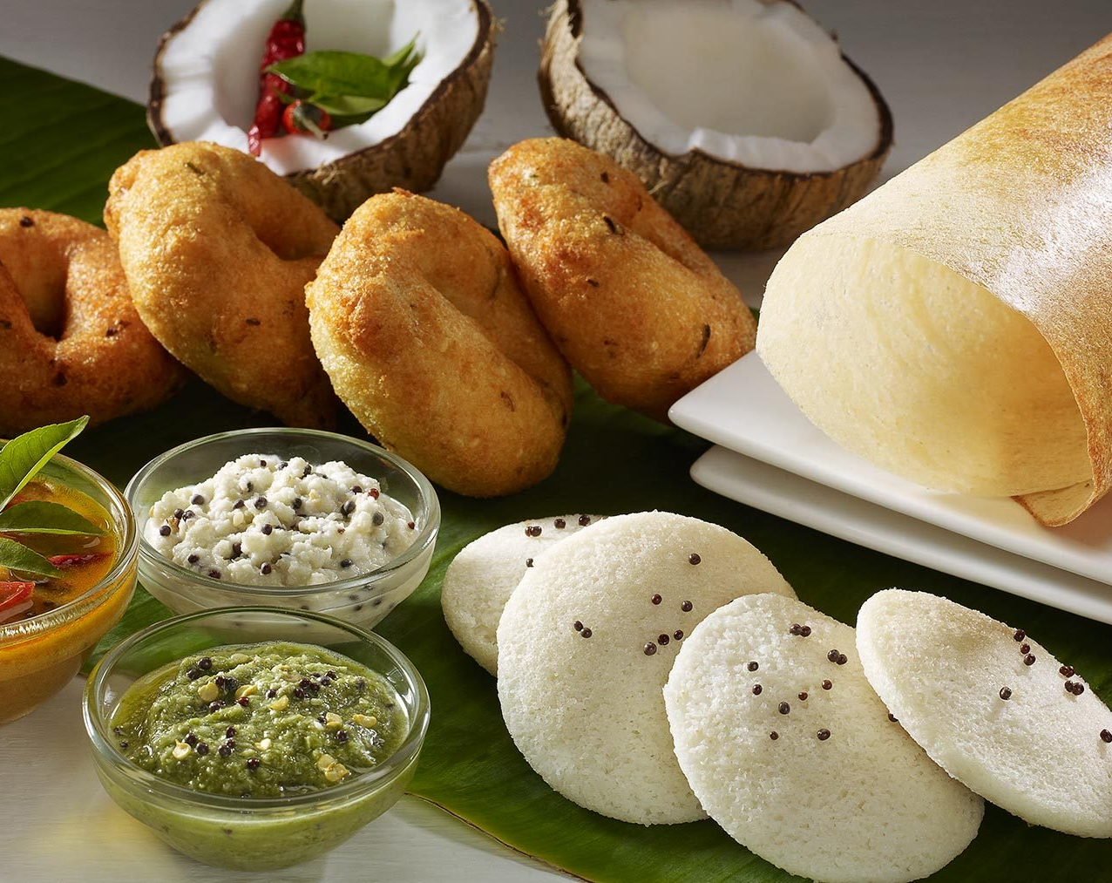
Identify a suitable area to start an Indian Restaurant in Toronto

Slide 2
Its very important for an Entrepreneur to find a suitable location for opening an Indian Restaurant.
This would bring him more profit and return on Investment.
Help in expanding future business.

Slide 3
https://developer.foursquare.com/docs
http://cocl.us/Geospatial_data
Data Acquisition
List of Neighborhoods in Toronto. Extracted from https://en.wikipedia.org/wiki/List_of_postal_codes_of_Canada:_M.
List of Postal codes
http://cocl.us/Geospatial_data
Four Square API
https://developer.foursquare.com/docs

Slide 4
Cleaning and Formatting Data
Webpage was scrapped using Beautiful Soup
Converted to data frame having 3 columns.
Got the latitude and Longitude based on postal code
Merged data frames to have below columns
Postcode, Burroughs, Neighborhood, latitude and Longitude.
103 rows were identified.

Slide 5
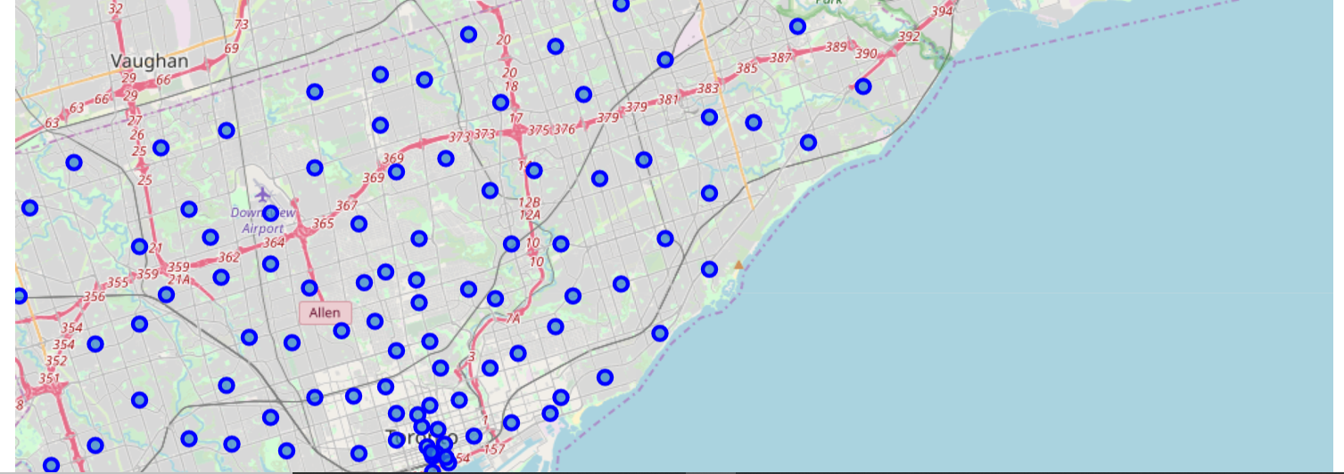
Marked Toronto Neighborhoods in a map

Slide 6
Four Square API
Identify venues and venue category using Four Square API
Grouped the data based on Neighborhood, Neighborhood Latitude, Longitude, Venue Latitude, Longitude and Venue Category
274 Unique Venue categories identified.

Slide 7
Clustering
Picked only the rows which has Indian Restaurants
Performed clustering with 3 clusters
Created new data frame which includes 3 clusters as well top 10 venues of each neighborhood which includes below categories
Indian, Asian, Thai and Chinese
Picked only the rows which has Indian Restaurants
Created a map which includes the venues from all 3 clusters

Slide 8
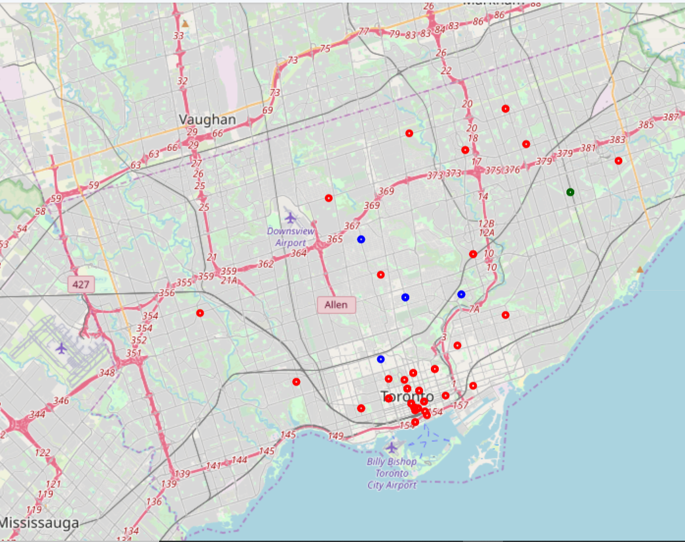
Cluster 0 – Red, Cluster 1 – Dark Green, Cluster 2 - Blue

Slide 9
OBSERVATIONS
Cluster 0 – Little Indian Restaurants and More Asian Restaurants
Cluster 1 - Most Indian Restaurants but with very less neighborhoods
Cluster 2 - More Indian Restaurants than Cluster 0 but lesser
than Cluster 1

Slide 10
Recommendations
Open an Indian Restaurant near Jamestown in Cluster 0
Great area in Northeast corner of downtown with lots of Highrise buildings, Offices and near Harbourfront.
This would offer lots of crowd and demand will be high in the area

Slide 11
Limitations and Future Recommendations
Main factor considered was number of Asian,Chinese, Thai and Indian Restaurants in Toronto area.
Future expansion prospects
Identify the population density ,rent and initial setup costs
Factor them to provide the recommendations.

Slide 12
Thank You

